Slide 1
Topic 11: Null hypothesis significance testing (NHST) versus information theoretic (IT) approach and model selection

Slide 2
“A model is always an abstraction and thus strictly always wrong!”
…but some models are useful and our goal must be to search for them

Slide 3

The more complex a model is, the better it fits the data and residual plots…
…but at what point do we stop adding complexity?
There is no unique answer to this question
https://docs.aws.amazon.com/machine-learning/latest/dg/model-fit-underfitting-vs-overfitting.html

Slide 4
Null hypthesis significance testing (NHST)
NHST expects mean = 0 or difference = 0
Complaints:
Arbitrary judgement concerning“statistical significance“
Confusing scientific hypothesis with statistic hypothesis (running after a nice p-value is not really a scientific hypothesis and a null hypothesis is a statistical test rather like a tool but not what is driving us to do science)
Null can be biologically trivial
Only single hypothesis – no multi-hypotheses
P-value focus often leads to forgetting about effect size (coefficients) and model strength (R²)

Slide 5
Information theoretic (IT) approach
Allows to define several plausible alternative hypothesis
Strength of evidence can be obtained for each hypothesis -> ranking
Which model is the
least bad (best) or
most plausible or
most efficient or
most likely to be truthful model
among all models in the list?

Slide 6
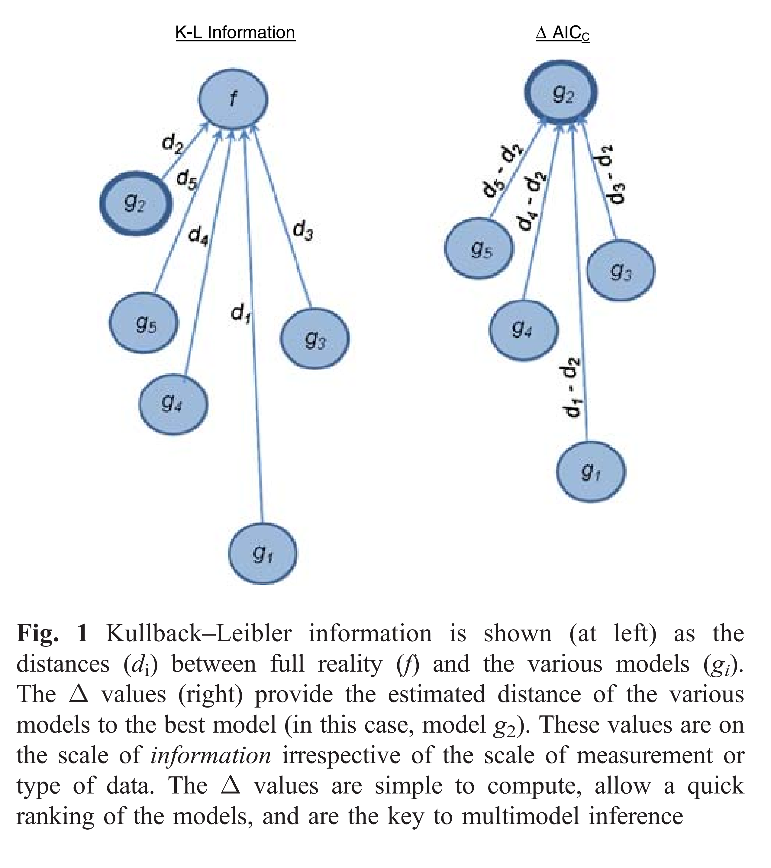
Information theoretic (IT) approach
Based on Kullback-Leibler‘s Information Theory (1951)
offers an estimate of the relative information lost when a given model is used to represent the process that generated the data
Akaike 1973 adapts this for statistical theory: AIC Akaike information criterion
Burnham et al. 2011

Slide 7

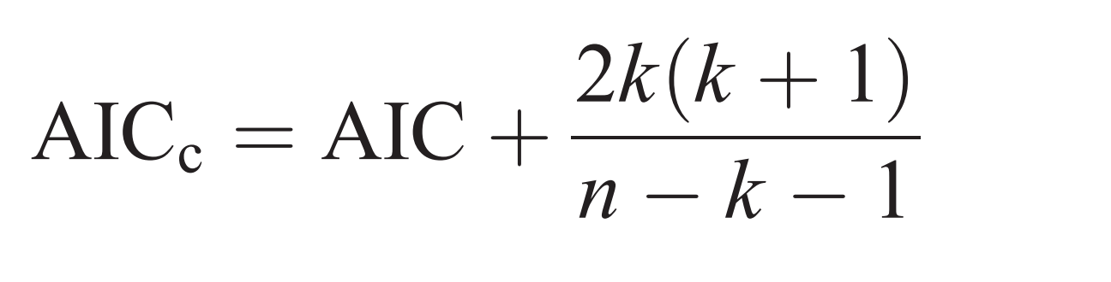
Akaike information criterion AIC
AIC is calculated using the number of fitted parameters in the model(k), and either the maximum likelihood estimate for the model (L) or the residual sum of squares of the model (RSS).
AICc = second order bais correction for AIC (Hurvich and Tsai 1989) corrects for small sample size and converges to AIC with larger sample size – so always use AICc

Slide 8
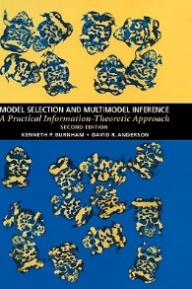
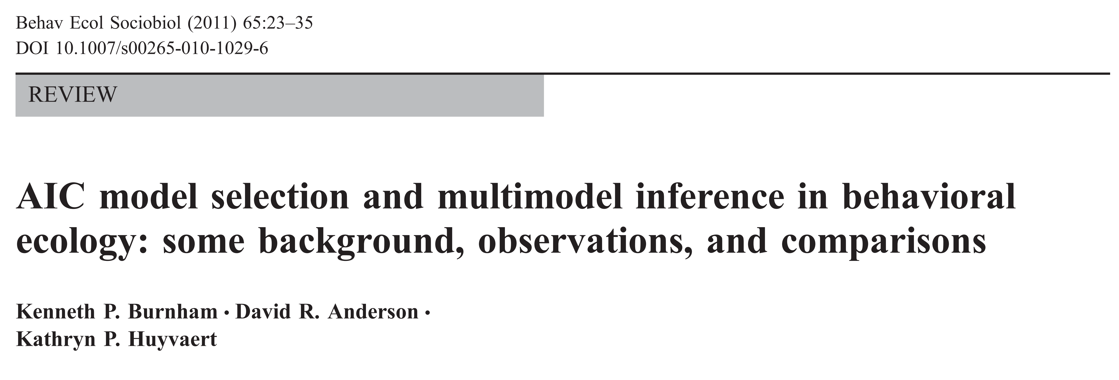
Model selection and inference based on AIC
Burnham and Anderson 1998 and 2002: fundamental book for model selection and inference

Slide 9
Δ AICc - Differences
Report the difference, Δ delta, between the lowest AICc (best model) and the next AICc (model i)
The larger Δ, the less plausible the model
Δ0-2: substantial support for model i = model i is equally good as the best model
Δ2-7: some support (but considerably less)
Δ >10: essentially no support
Burnham et al. 2011

Slide 10
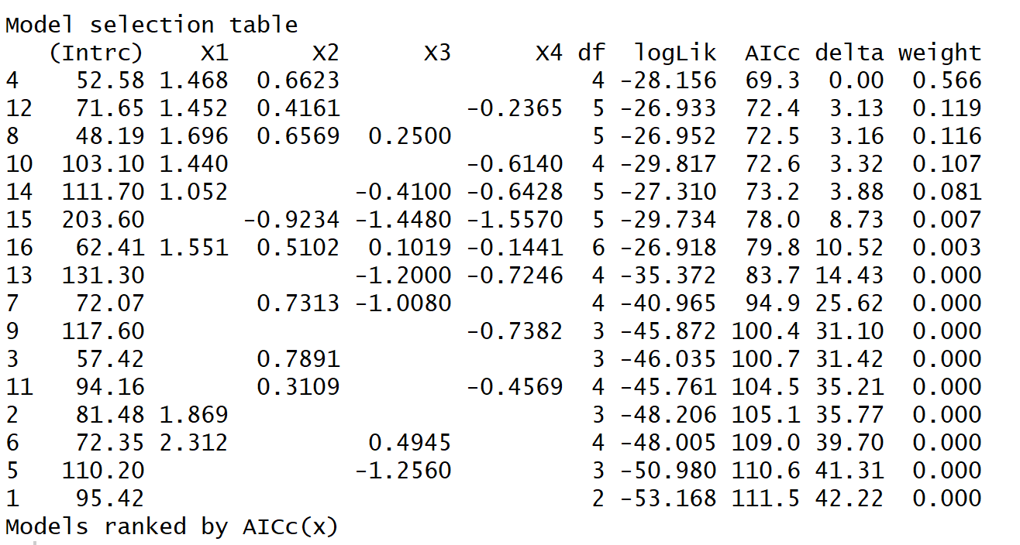
Example for R output

Slide 11
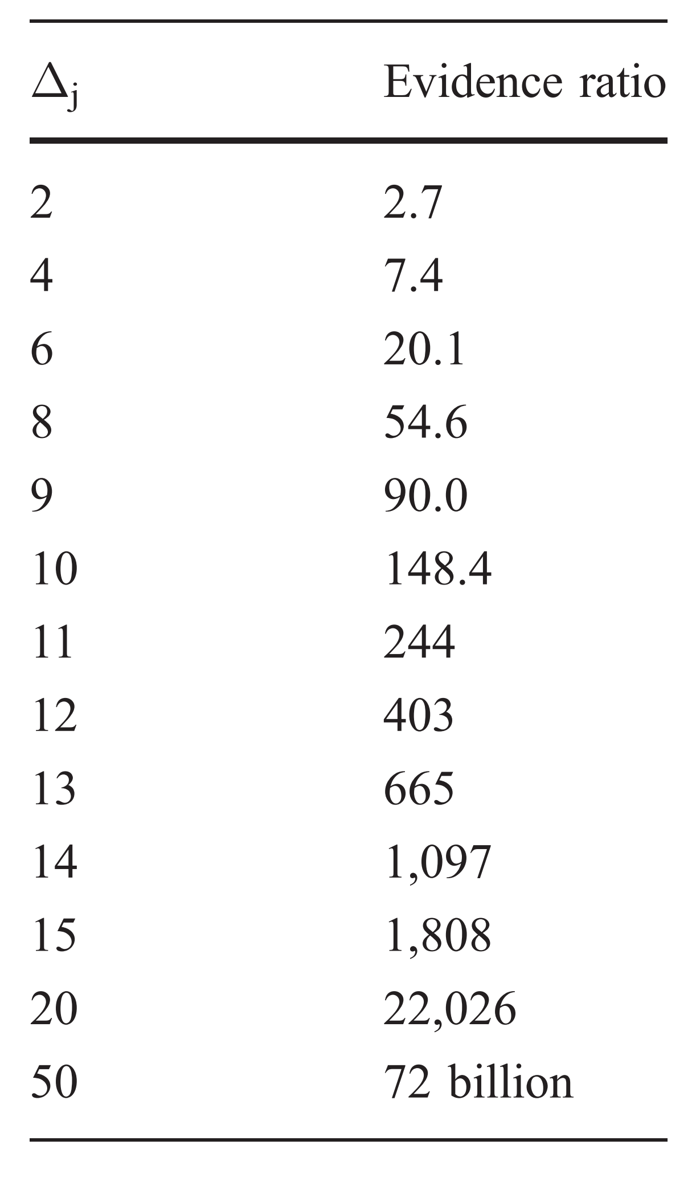
AICc weights and evidence ratio
Report the weight of each AICc, which is the likelihood of each model out of all calculated ones, i.e. the probability that model i is best among the listed models
The evidence ration can be calculated for any two models i and j: weight model i / weight model j e.g. 0.566/0.119 = 4.756 i.e. the empirical support for model i is about 4.8 times higher than for model j (don’t use the term “significant”)
Burnham et al. 2011

Slide 12
What to do with many „best“ models – small Δ AICc values?
Often several models have a very similar AICc, weight and thus likelihood
-> Solution: Multimodel inferences with model averaging
In general inference can (should) be made on all models in the a priori set!
All models or a subset of models will be averaged and predictor variables will be ranked based on their relative importance!

Slide 13
Model selection
In the past and still stepwise model selection is used, based on AIC ranking or p-values. (the latter is the worst!)
And none of the stepwise methods (backward, forward, both, or blockwise inclusions/exclusions) can be recommended!! Whittingham et al., 2006

Slide 14
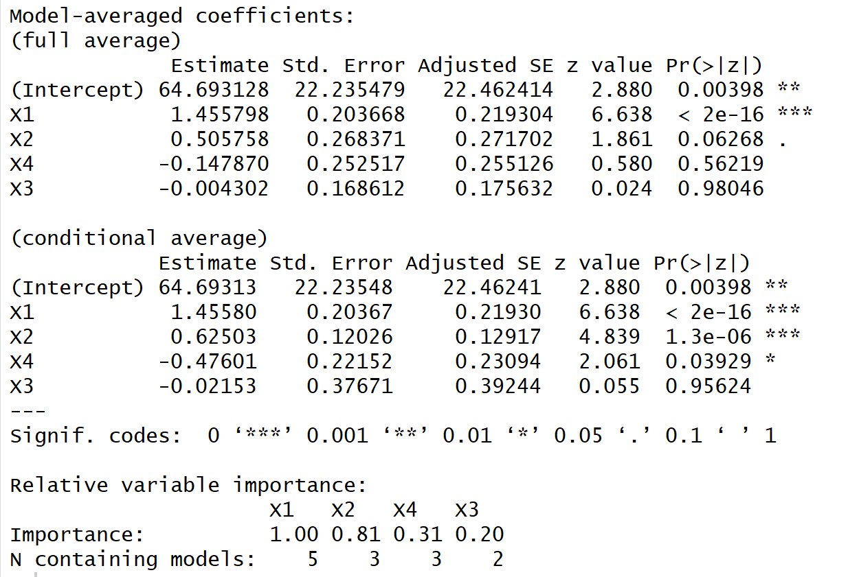
Example for R output
Important: do not use the p-values of averaged coefficients!!!

Slide 15
Multimodel inference
in R e.g. with package MuMIn
Difference between full and conditional average:
Full average: in cases where high model selection uncertainty exists (i.e. the best AIC model is not strongly weighted) – typically in all-subset modelling
Conditional average: in cases when there is strong support for the best model (weight>0.9)
Report the averaged estimates + adjusted SE and the relative importance

Slide 16
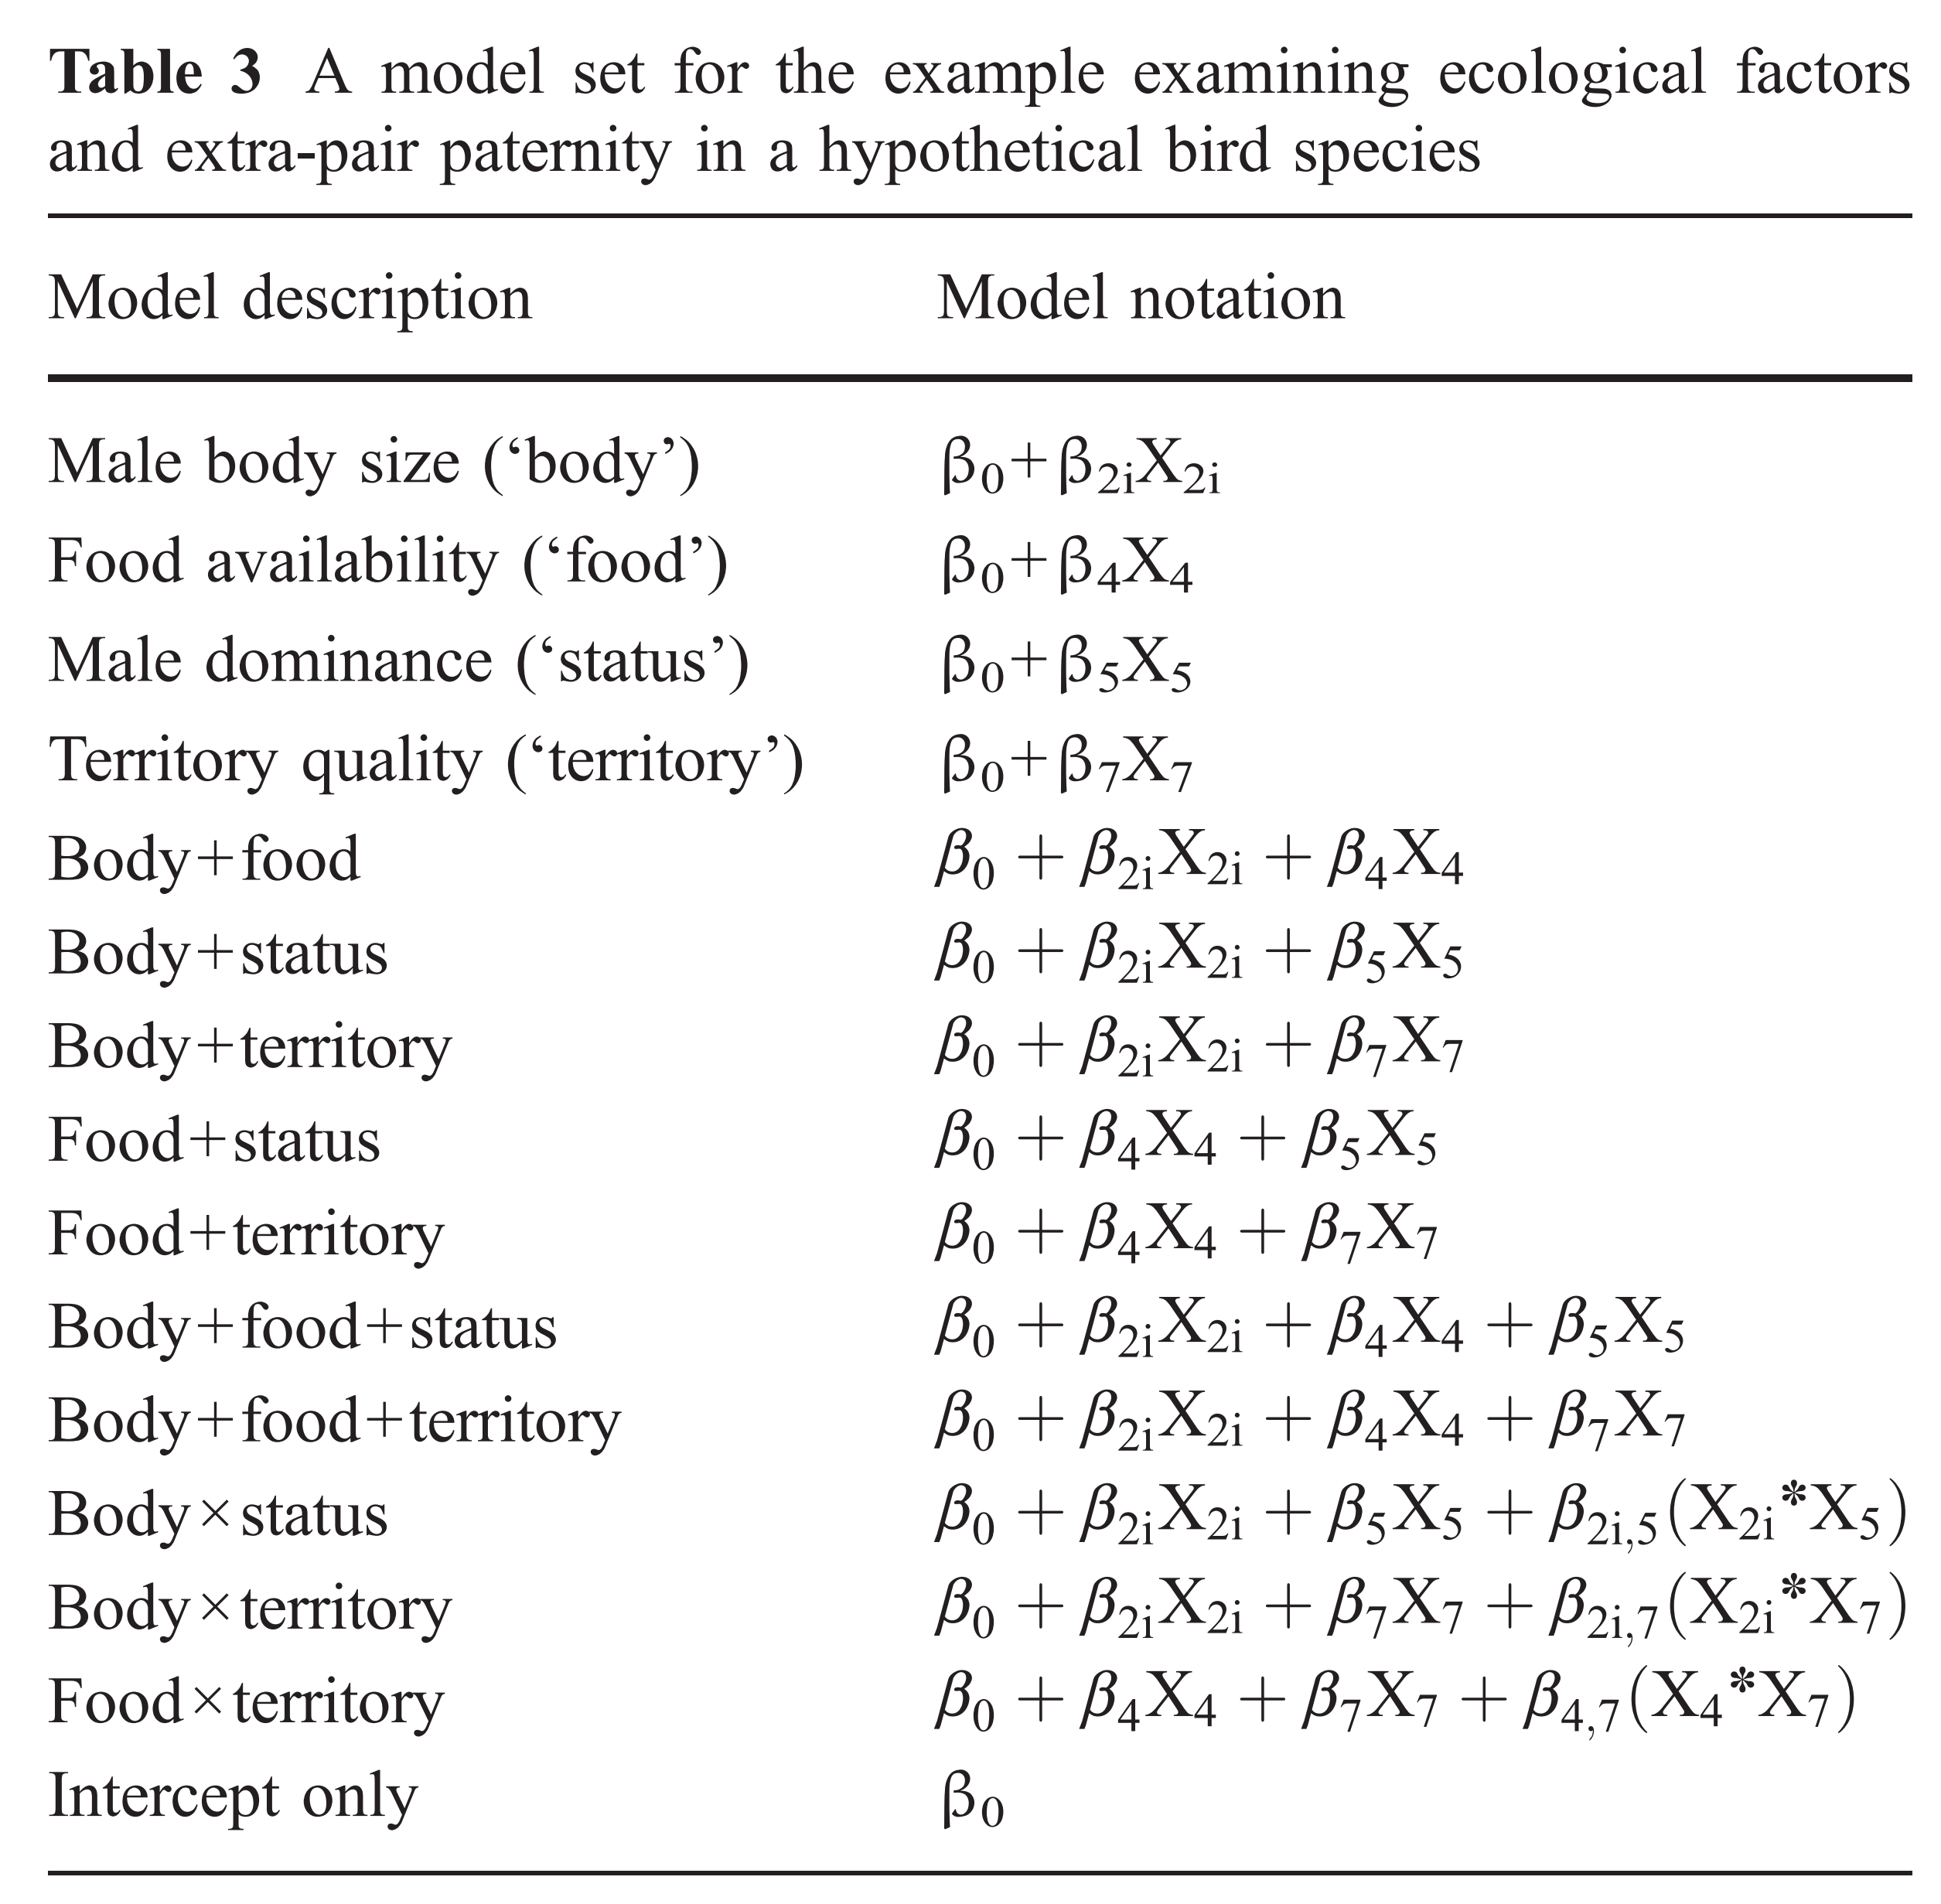
How to create a model set a priori?
Hard thinking!!! What does makes sense? Each model is a hypothesis – which alternative models are useful?
This can be a long process and ideally happens before the data collection!
Include the null model!
Alternative:
all-subset modelling: refers to computing all possible model combinations – often critisized
Burnham et al. 2011

Slide 17
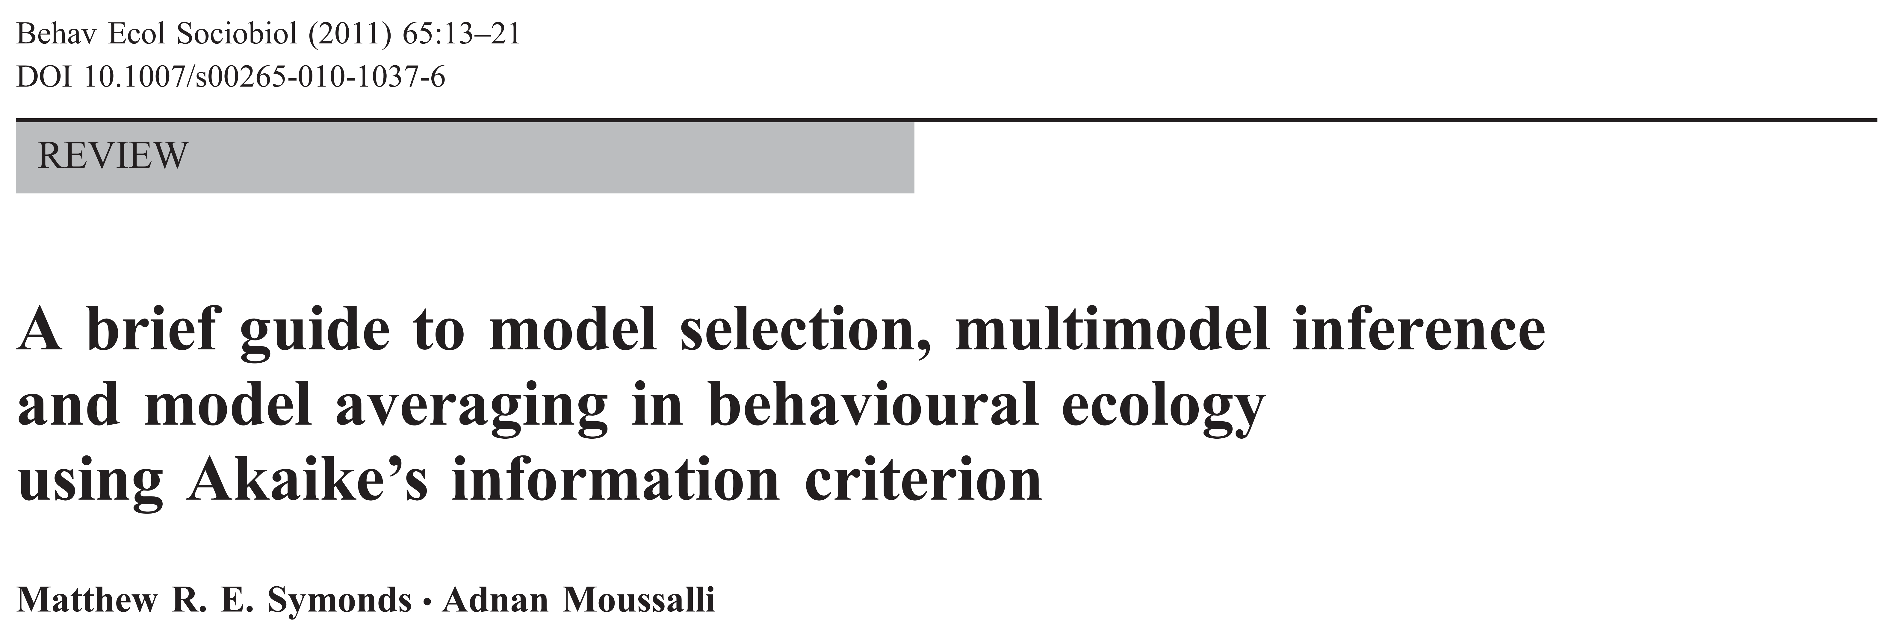
A great guide to model selection

Slide 18

In the appendix contains a worked example for multimodel inference including interepretation.
Only take care with the proposed functions to calculate Confidence Intervalls and to male prediction – this is not perfectly correct (see Corrigendum of the paper)
Currently, it is only possible with Bayesian methods to take into account all uncertainties.

Slide 19
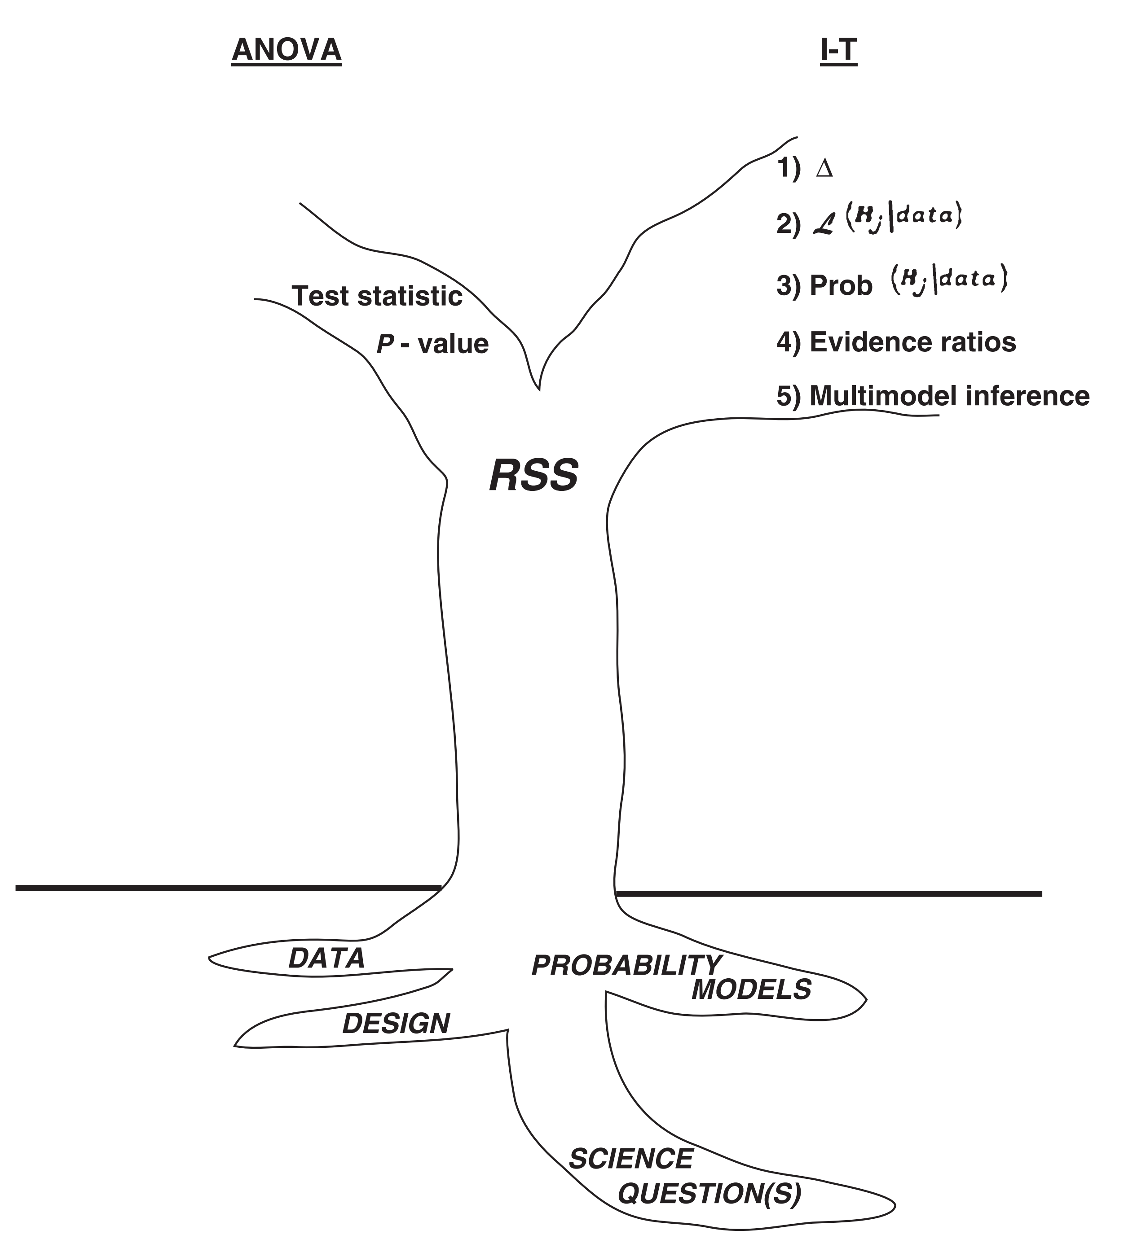
NHST versus IT
Burnham et al. 2011

Slide 20
When to use what?
NHST
For planned controlled experiements
Randomized and replicated treatments
Few treatments (>3)
BUT: report coefficients, not just p and CIs and R²
Ideally we have simple experiments
IT
For more complicated experiments (e.g. mixed effects, nested)
Regression models
Observational data
Also report coefficients, CIs and and R²
Reality often much more complicated

Slide 21
Further information
Model selection with AICc https://www.youtube.com/watch?v=7XAHjm6Vy5k&t=148s
Other interesting topics of the same author (but I did not check it‘s reliability): https://www.youtube.com/channel/UCExBFDFe1XbNbto0yYXaxPg
Criticism on using AIC: https://www.youtube.com/watch?v=lEDpZmq5rBw&t=305s

